Slide 1
My Management Philosophy
Emma Christensen
December 2016

Slide 2
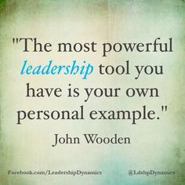
“Lead by Example…”
If there is one statement I have heard throughout my life, it is to “lead by example.” Not only have I heard this from my parents, but also from coaches, teachers, and managers. Through this statement, I have learned that you will not earn others’ respect if you are not willing to put all of your effort into your job and do what it takes to succeed.

Slide 3
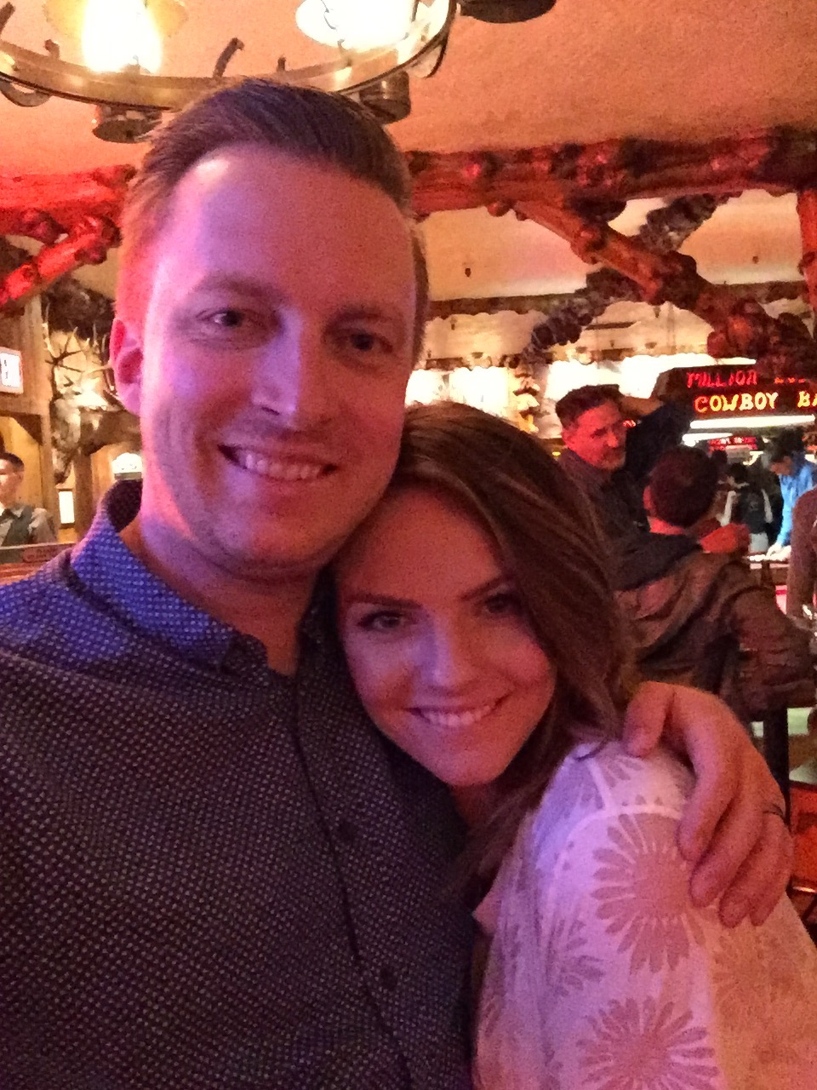
My Biggest Inspiration
One person in my life who epitomizes leading by example is my husband. Since meeting him, I have seen how hard he works to be an understanding, fair, and patient manager. When he puts his mind to something, he always accomplishes it, even if he has to learn everything as he is doing it. His work ethic inspires me to put 100% into everything I do and never stop pushing myself to be better.

Slide 4
Traits of a Great Manager
According to entrepreneur.com, these seven traits turn a good manager into a great manager:
Having a great attitude
Being transparent
Demonstrate maturity
Remain flexible
Reinforce accountability
Get their hands dirty
Develop great talent

Slide 5
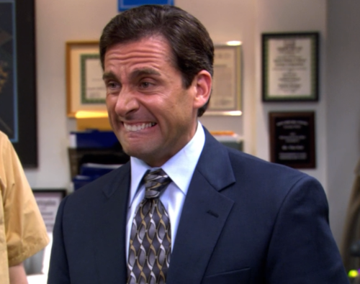
Having a Great Attitude
“Good managers stroll up the stairs, great managers run up the stairs.”
One of the most important aspects of a great manager, in my opinion, is keeping a positive attitude. When a leader is negative about something, or they are constantly stressed out about little things, it makes the work environment negative. Great managers should be able to stay positive, even in times of stress.

Slide 6
Being Transparent
“You cannot be a great manager if you sugarcoat things.”
Transparency within business is something that great managers should strive for. Great managers should know how to shut out rumors before they happen. They should also be able to own up to mistake they make or give their employees full disclosure on certain aspects of the company. If a company is going through hardships, it is a managers responsibility to let their employees know.

Slide 7
Demonstrate Maturity
“Exceptional managers consistently fly above the noise and don’t get caught in emotional traps”
It is easy to get caught up in office politics and gossip, but great managers are able to not only ignore these things, but also put them to rest. Work is not the place for these behaviors and managers know that to keep a positive environment, they need to stay away from getting caught up in the latest scandal.

Slide 8
Remain Flexible
“When things get bumpy they embrace ambiguity and make others comfortable in dealing with change.”
In the business world, it takes teams of people to accomplish their goals; one person can not do all of the work alone. Therefore, great managers know that in order to achieve their goals, they need to get to know each employee and how they work. They need to evaluate which employees work well together, so they can produce the best product possible. Managers should also encourage new opinions and set aside their own when appropriate.

Slide 9
Reinforce Accountability
“They are vested in driving solution-based cultures and strive to build an environment of continued learning (versus finger pointing)
Taking accountability for your actions is one of the best traits a manager can learn. Great managers can bring a team together and create the knowledge that if they succeed, they succeed as a team; it is not one person that takes all the credit. On the flipside, if they fail, managers make sure that there is no finger-pointing and the team as a whole takes responsibility.

Slide 10
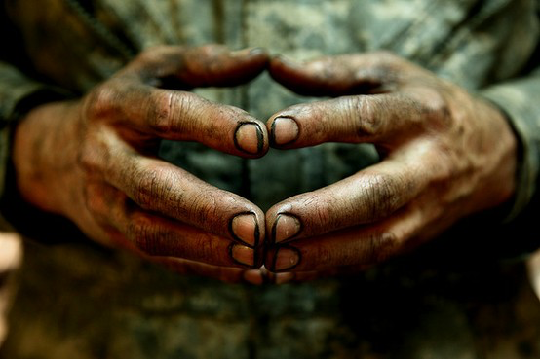
Get Their Hands Dirty
“They show them how to be successful if they are falling behind and demonstrate best practices to help guide them along.”
This trait of a great manager is my personal favorite, because I feel that if a manager is willing to do the same work their employees do, even when they don’t have to, it shows what kind of person they are. Managers should never see themselves as being “above” a job. To truly run their business properly, great managers know that they need to be ready to do any job. I believe this shows employees that if they are ready and willing to do it, then the employee should be ready and willing too.

Slide 11
Develop Great Talent
“They are able to get the right people in the right roles at the right time.”
Great managers know that they are not able to do every job and they also know they cannot succeed with people who are not willing to put in the time. In order to get the best talent available, they create career opportunities and specify exactly what they are looking for. Once they are able to bring a new employee in, they mentor and mold them into the type of employee the company needs.

