Slide 1
Parks, Recreation, and tourism
Hospitality Management Emphasis
By Emma Christensen
April 7, 2016

Slide 2
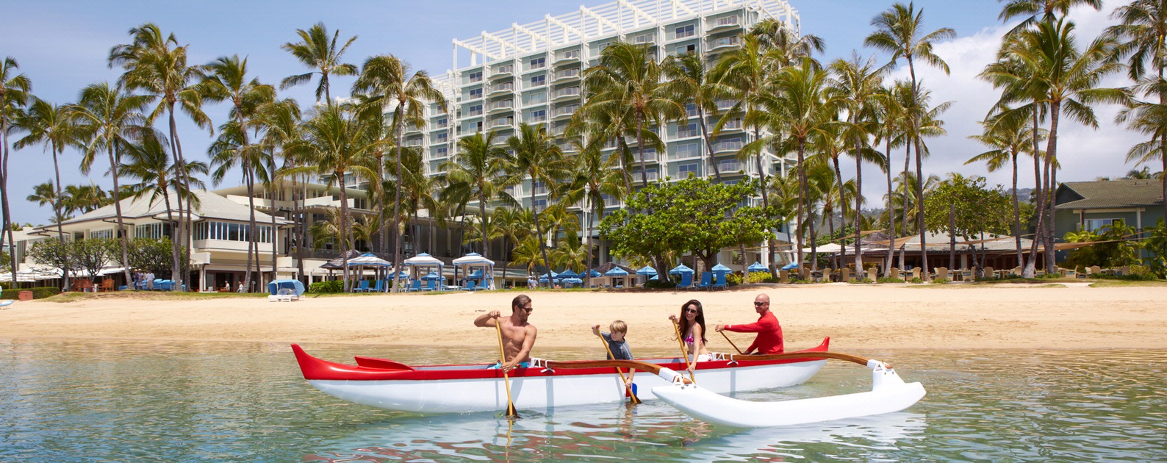
What is Parks, Recreation, and Tourism?
Within the Parks, Recreation, and Tourism degree, you will learn how to manage recreational activities in a sustainable way that preserves the nature of the environment around us.

Slide 3
What is Hospitality Management?
Hospitality Management includes many different businesses that include hotels, restaurants, airlines, and tour agencies. The hospitality management emphasis will teach you how to work within the hospitality industry, serving people with great customer service and knowledge about the industry.

Slide 4
What classes do I take?

Slide 5
Clubs to join within Prt
RAPS Facebook Page
AHLA Website

Slide 6
Certification requirements for your degree
Must be a part of a professional organization (RAPS, AHLA)
First Aid certification

Slide 7
Internships
PIC
Work/volunteer with at least 2 separate organizations that makes up 300 hours. You may use prior work experience for the PIC.
Summer Internship
Working within the field to integrate yourself into the industry.

Slide 8
Careers within Hospitality management
There are many career options for someone who studies hospitality management, but some examples are:
Catering Manager
Event Planner
Restaurant Manager
Hotel Manager
Travel Agent

Slide 9
Who do I contact on campus for questions regarding prt?
Eric Gardner (Undergraduate Advisor)
eric.gardner@utah.edu
801-585-0832
Dr. Betsy Cook
(Director of Undergraduate Studies)
elizabeth.cook@health.utah.edu

Slide 10
References
https://www.prospects.ac.uk/careers-advice/what-can-i-do-with-my-degree/hospitality-management
http://study.com/directory/category/Business/Hospitality_Management.html
http://www.clemson.edu/degrees/parks-recreation-and-tourism-management
http://www.health.utah.edu/parks-recreation-tourism/degrees/bachelors/hospitality-management.php

